Slide 1
Employee Attrition Analysis
for PharmaHR
2023

Slide 2
01
Fanshu Yu
24684336
02
Hasim Rahman
24674715
Group
members
03
Muhammad Rizwan
24878187
04
Thuy Linh Nguyen
24711386
05
Yuechen Shi
14021620

Slide 3



Introduction
Business Understanding
Business Background: Pharmaceutical Company
In today's presentation, we address the critical issue of high employee attrition at PharmaR.
This problem negatively impacts project timelines, HR costs, and training efforts, posing a challenge to our company's success.
Our goal is to model attrition probability and provide actionable recommendations to improve employee retention.
01
Objectives: Reduce Attrition
Success Criteria: Identifying variables contributing to attrition

Slide 4
Business Objectives
A
Model the probability and scale of attrition using our 2019 data.
Our objectives are clear:
Understand the key factors driving employee attrition.
Provide actionable recommendations to mitigate the impact of attrition on the company.
B
C
Our findings will shape strategies for improved retention for valuable employees in 2023.

Slide 5

Research Questions
01
Our analysis focuses on answering key questions:
What factors are significant contributors to employee attrition?
02
How can we predict attrition probability and associated costs?
03
What actionable strategies can we recommend to address attrition effectively?

Slide 6


Project Planning
Data collection
Utilize various datasets for comprehensive analysis.
Data exploration & preprocessing
Our approach involves several steps:
Understand data structure and content.
Clean and prepare data for modeling.
Feature selection
/ engineering
Identify relevant features.
Modeling &
Evaluation &
interpretation
Recommendations
Build predictive models for attrition estimation.
Assess model results.
Deliver actionable insights for the company.

Slide 7

02
Data Understanding

Slide 8
Data Overview
Datasets for analysis include:
01
02
03
04
05
PharmaHR_2019_Employee_Database.csv
PharmaHR_2019_employee_login_time-5.csv
PharmaHR_employee_logout_time2.csv
PharmaHR_employee_satisfaction_survey_data2.csv
PharmaHR_manager_evaluation_data2.csv

Slide 9
Data Overview
Data Description
Data Overview
1.Data Source:
4.Key Attributes:
Datasets | Employee Database | Login Times | Logout Times | Employee Satisfaction | Manager Evaluation
Total Variables | 24 | 262 | 262 | 4 | 3
Quantity of Data | 4410 | 4410 | 3633 | 3633 | 3633
Type of data | Employee Information | Dates and times of Employee logins | Dates and times of Employee logouts | Ranking based on level of satisfaction | Employee performance rating by the manager

Slide 10
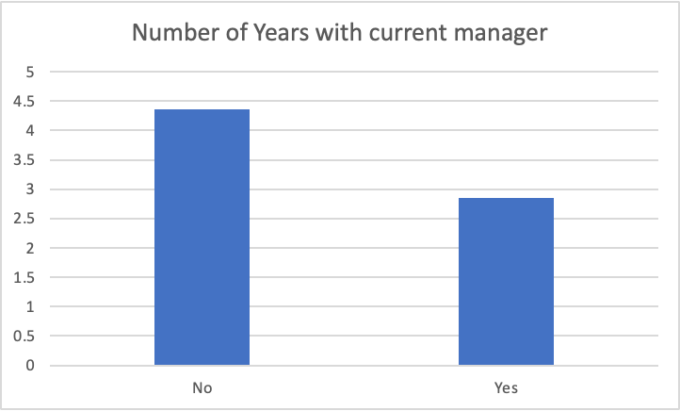
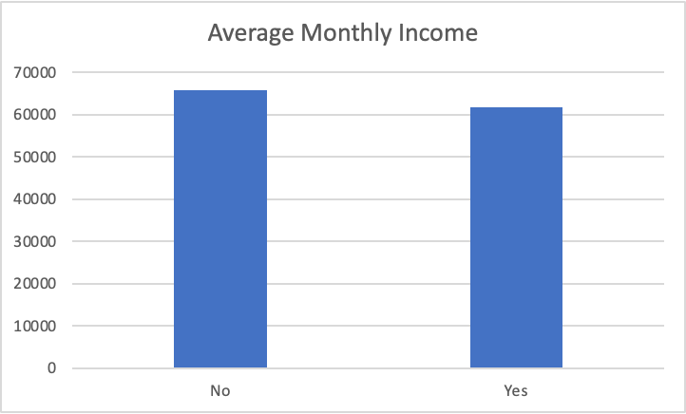
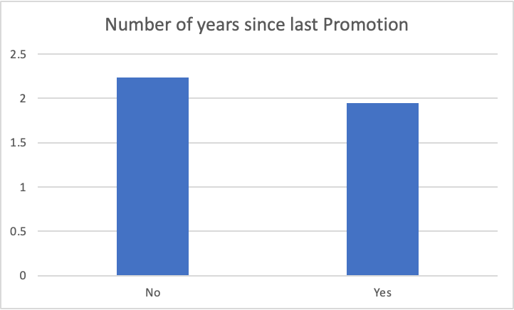
Preliminary analysis:
Initial Hypothesis
Findings
Insights
It was to be expected and assumed that some variables like salary might have a connection with attrition
Variables showing a trend with Attrition:
Monthly Income
Years since last promotion
Years with current manager
Average salary of the employees that left slightly lower than the employees that stayed.
People who left were on average given a quicker promotion.
Employees that worked under the same manager for a long time had lower attrition.
The HR department saw the highest level of Attrition at 30.1%

Slide 11

Data Quality Assessment
Key observations regarding data quality:
Missing Values:
Data of 777 employees missing from Logout, Employee Satisfaction survey, and Manager Evaluation data.
No Outliers were found in the data
Login and Logout times were in date and time format which would require data cleaning for meaningful insights to be derived from it
Tables | Missing Data
Employee Database | 28
Login | 109080
Logout | 43596
Satisfaction Survey Data | 66

Slide 12
Conclusion of Initial Steps
Key achievements so far:
Established business context and objectives.
Defined research questions to guide analysis.
Outlined the comprehensive project plan.
Provided an overview of available data and its preliminary exploration.
The mean age of employees is 36.8.
About 16% of all employees chose to leave their jobs.
The HR department has the largest percentage of employees, approximately 30%, choosing to leave.
Approximately 25% of employees who travel frequently choose to leave their jobs.
The turnover rate for employees who travel occasionally is 15%.
Employees who do not travel have the lowest turnover rate of approximately 12%.
There are a lot of missing values that need to be addressed
From the overview, a significant trend can be seen in the Number of years with current manager and attrition rate.

Slide 13
03
Data Preparation

Slide 14
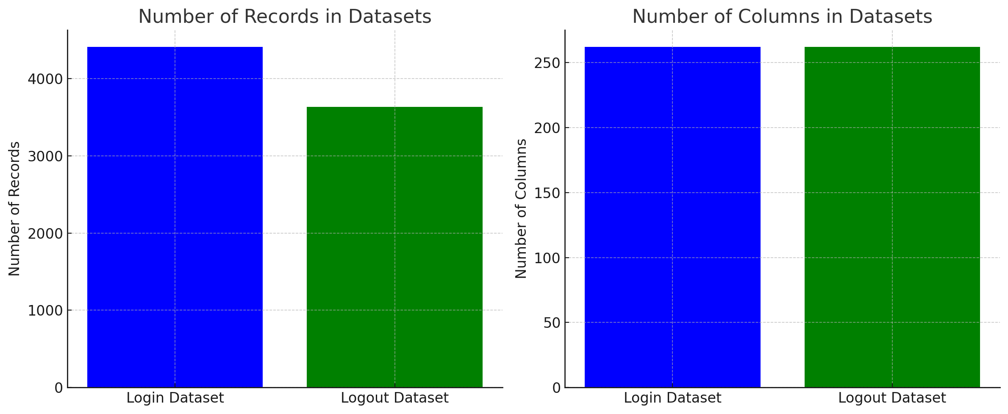
Clean Data
Overview of Datasets:
Login Dataset:
Number of records: 4410
Number of columns: 262
Logout Dataset:
Number of records: 3633
Number of columns: 262

Slide 15
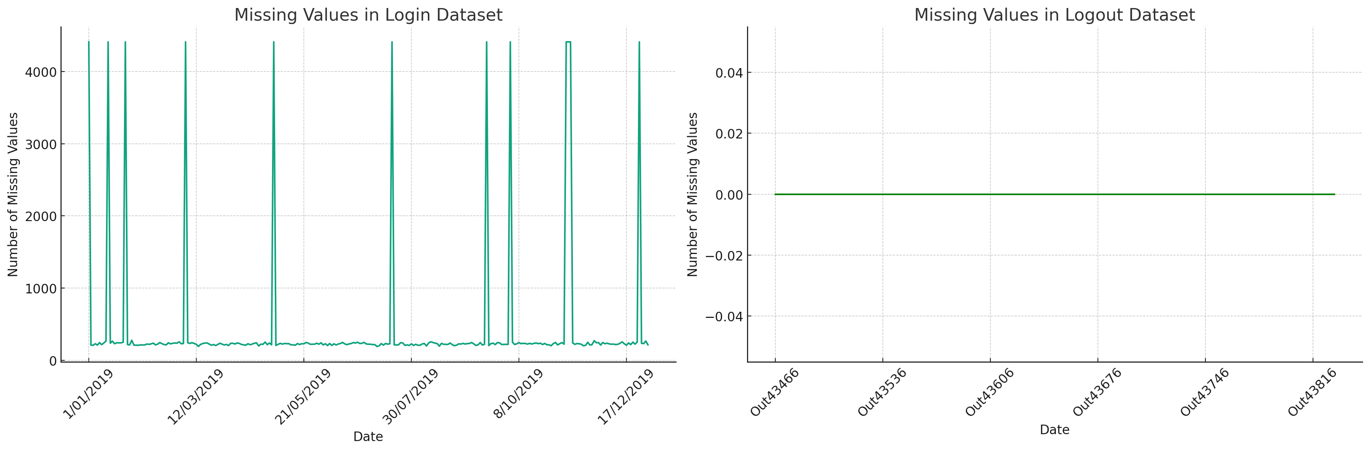
Missing Values
The Login Dataset shows periodic spikes in missing values.
Certain dates like 1/01/2019 and 25/12/2019 have significantly higher missing values, hinting at possible non-working days.
The Logout Dataset has no missing values, indicating consistent data recording.

Slide 16
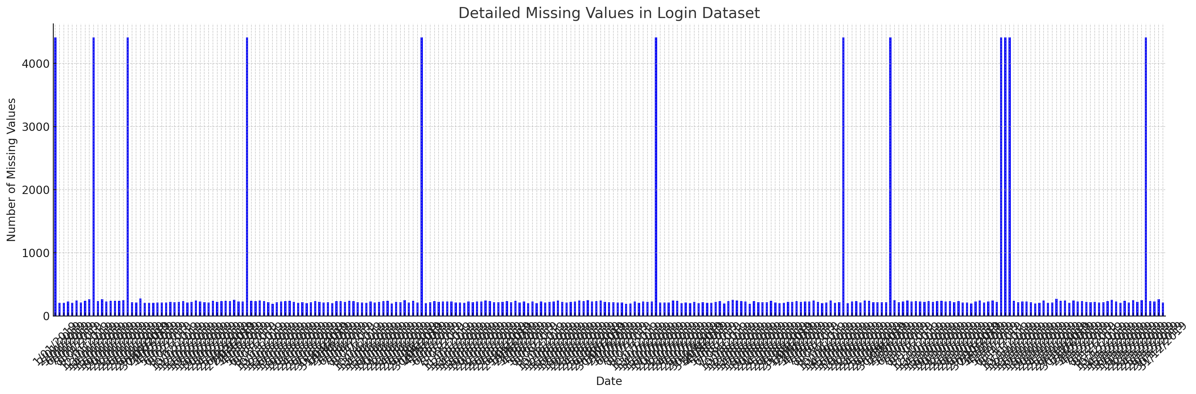
Detailed Missing Values in Login Dataset
Dates like 1/01/2019 and 25/12/2019, with 4410 missing values each, stand out and might be significant holidays.

